Slide 1
Single-Factor Experiments
Two-Factor Experiments
only a single factor varies
A two variable factors.
Fertilizer trials where several rates of a single fertilizer element are tested.
Insecticide trials where several insecticides are tested.
Effect of Nitrogen Levels on the growth of different Wheat varieties
To evaluate the effect of fertilizer type and irrigation level on wheat yield

Slide 2
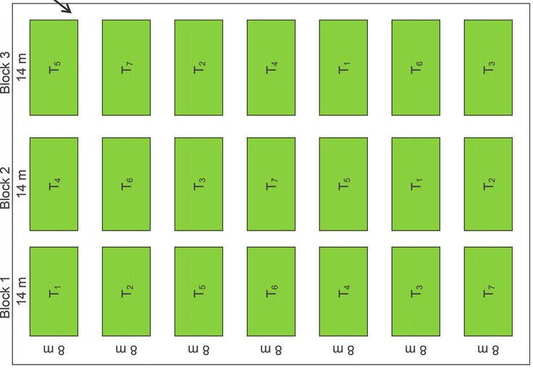
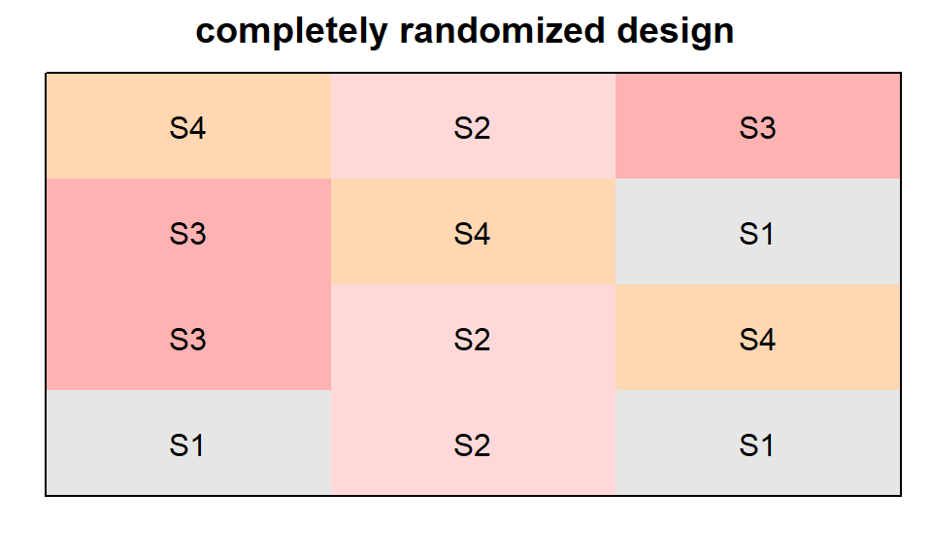
Completely Randomized Design
Randomized Complete Block Design
Treatments are assigned completely at random
Appropriate for homogeneous experimental units
The experimental area has a predictable productivity gradient.
Suited for field experiments
Productivity gradient

Slide 3
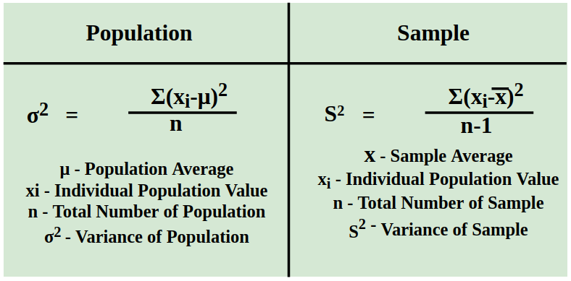
Variance
The spread or dispersion of a set of data points around the mean
Bessel’s correction
n-1

Slide 4
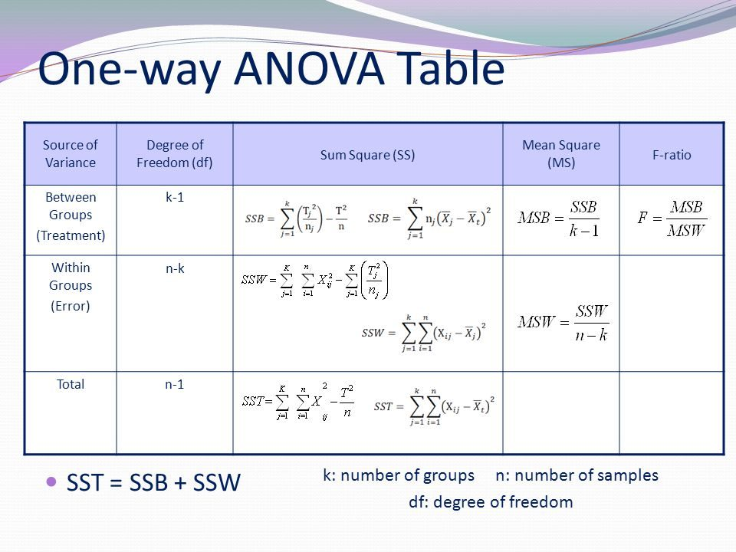
ANOVA Table

Slide 5
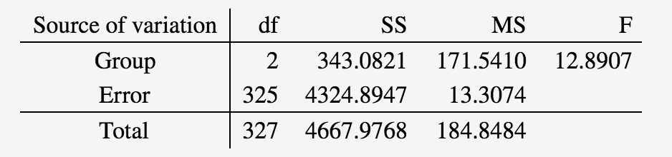
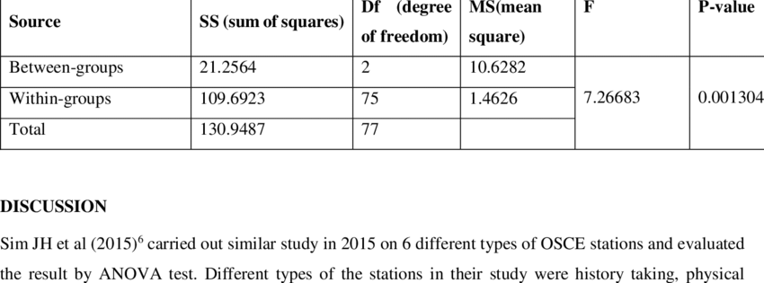
Sample ANOVA table
Source of variation | df | PH | LH | CPP | CL | CD | RPC | GPR | DM | AD50 | SD50 | 100SW | KWP | ASI
Replication | 2 | 0.006 | 0.13 | 0.02 | 2.10 | 0.06 | 0.28 | 6.1 | 0.4 | 0.13 | 0.18 | 1.25 | 449.7 | 0.02
Variety | 9 | 1.09*** | 2.41*** | 0.18*** | 69.15*** | 0.21*** | 4.76*** | 214.22*** | 16.16*** | 7.90*** | 17.30*** | 32.91*** | 4432.7*** | 4.00***
Error | 18 | 0.007 | 0.04 | 0.03 | 2.89 | 0.02 | 0.29 | 16.24 | 1.80 | 0.05 | 0.08 | 3.49 | 200.6 | 0.037

